Slide 1
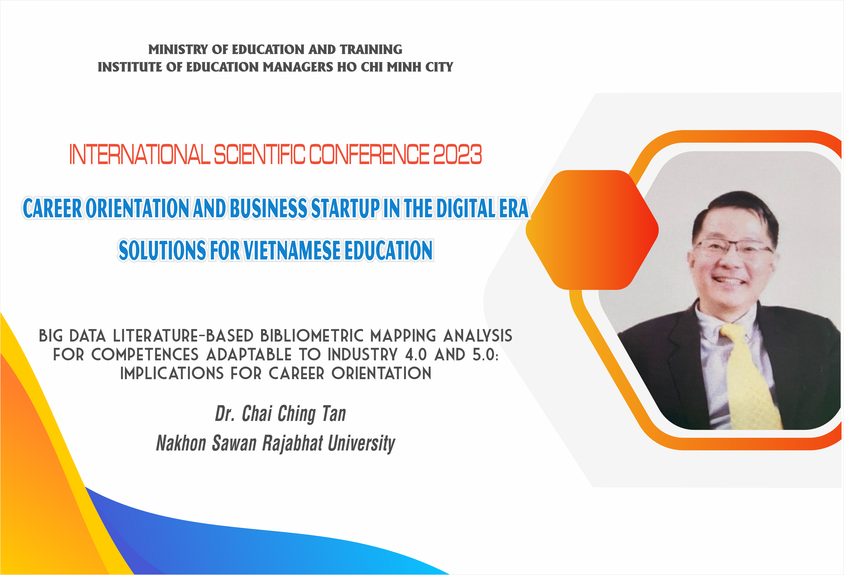

Slide 2

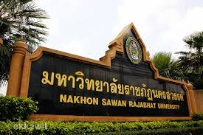
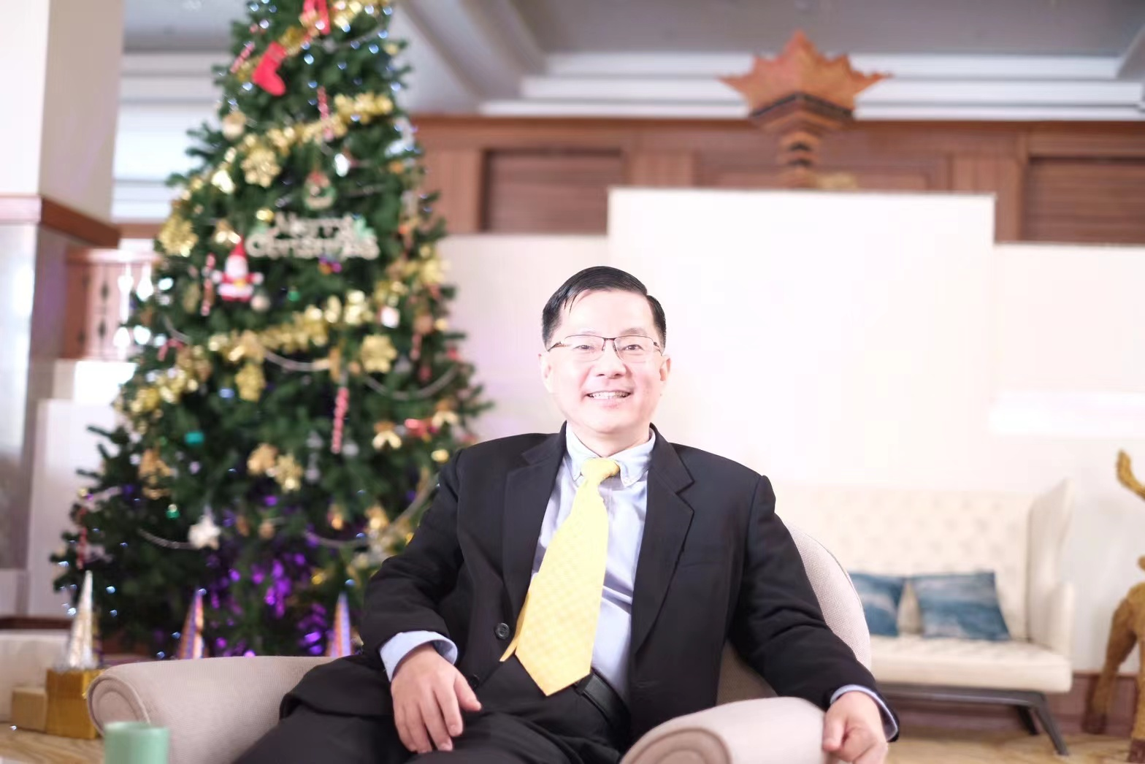
A Competence Perspective of “Career Orientation” in the Context of Industry 4.0 and Industry 5.0 – Derived from the Bibliometric Base.

Slide 4
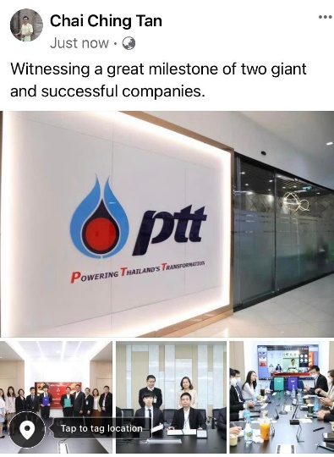

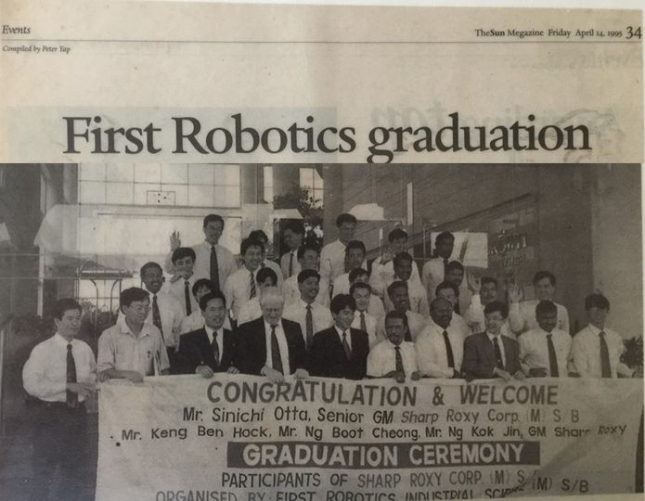
Brief Bio of Dr. Tan:
US Naval Research Scholarship – US Submarine Propulsion, Research Engineer. Three Elsevier Q1 Publications.
Bachelor of Science and Master of Science in Mechanical Engineering, University of Wisconsin-Milwaukee, USA.
Master: Advanced Business Practices, The University of South Australia.
Doctor of Business Administration, Southern Cross University.
ISO 9001:2000 Series Lead Auditor Certification.
M.IEAust. Professional Engineer Member, The Institute of Engineers Australia.
Currently: Assistant to President, Foreign Affairs, Nakhon Sawan Rajabhat University, Thailand.
Strategy consult with the Senior Executive Vice President of the Petroleum Authority of Thailand (PTT)
Academic Associations: President, ASEAN Academic Network; Foreign Secretary (Previously, Vice President) of FATER Academy of India.
Chief and Associate Editor of International Peer-Reviewed Journals: JSSH, IJMMT. IJBM.
Senior Faculty, Mae Fah Luang University, Rajamangala University of Technology Rattanakosin
Assisting Vice President as Management Specialist, Rajamangala University of Technology Tawan-OK
Vice President, Strategy, Factory, HRD, Seafresh Industry Public Company Limited.
General Manager, Asia Pacific Region, VAUTID Thailand and KOMOTECH Korea, Duramat Suriyathip Thailand
Group Technical Manager, Hong Leong Group Malaysia.
Principal and Director, FRIS Institute of Robotics, Malaysia
Research Scholar, University of Western Australia – Robotics Control.
Faculty of Mechanical Engineering, Chiang Mai University and Mahanakorn University of Technology
Peer-reviewed Publications: Over 300. Over 100 International Awards. Nine International/Thailand Research Funds.

Slide 5

Although at the exploratory level, using the big-data bibliometric method, we aim to enrich the competence perspective in “career orientation” – That “competence” is situated in the background to influence our choice of careers, but the extant literature provides very little update of the research of it.
We aim to:

Slide 6


Why Career Orientation?
Being aware of what we value and are good at (competent) is critical, as they influence our thoughts, attitudes and behaviors (such as our career selection and work settings, consciously or unconsciously), and outcomes such as psychological success that our jobs are meaningful and we met it → That is, aware of what we anchor on our career aspiration and how we want our career to be like is central to our career satisfaction, career self-management, and career success.

Slide 7
What do we typically anchor on in our career vision and choice?
For instance: According to Schein (1987):
Security/stability
Autonomy/independence
Managerial and technical/functional competence
Entrepreneurial creativity
Sense of service
Pure challenge
Lifestyle integration
Career Decisions
Shape
Career Anchors:
Needs
Values
Talents and Competences

Slide 8

The earlier we identify our career anchor or orientation, which we must also consider industry and social context and requirements (such as Industry 4.0 and Industry 5.0), the better we will be able to lead a meaningful career. Otherwise, for instance, boundaryless careers (similar to “parallel” structures in an organization, matrix organization, and quality circle in TQM) will seem aimless.

Slide 9
A bibliometric study using the keywords “career orientation”, “career anchor”, “career success”, and “career success” yields:

Slide 10
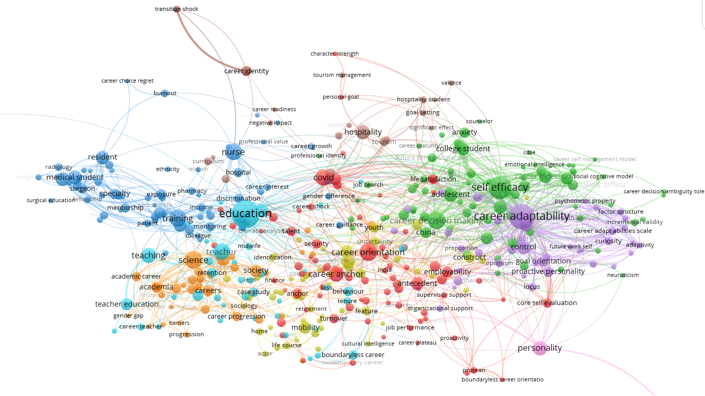
Bibliometric Map: Source: Own Research
Career Orientation, Career Anchors, Career Decision

Slide 11
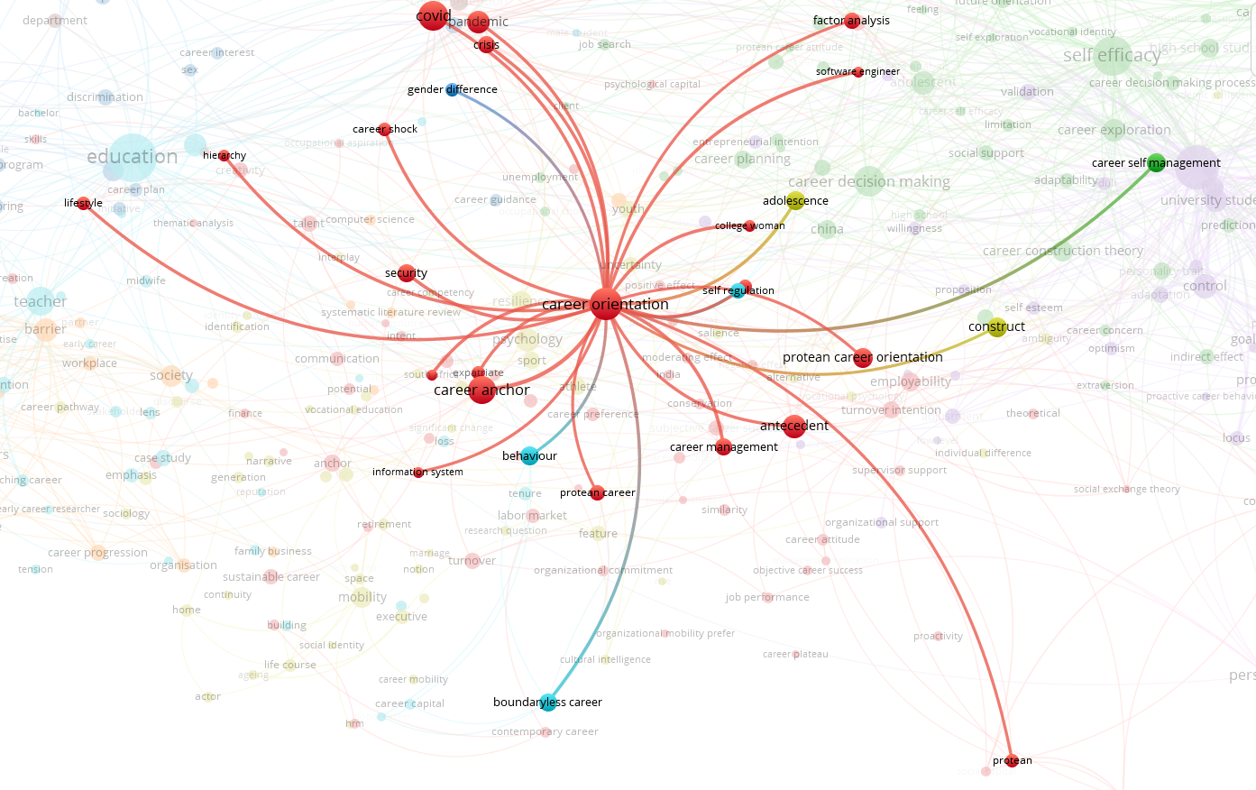
Research Repertoire Structure of Career Orientation
Career Orientation
Bibliometric Map: Source: Own Research

Slide 12
Research Repertoire Structure of Career Orientation
Antecedents
Career Orientation
Behaviors and Outcomes
Demographic (education, gender, age)
Self Awareness and SWOT (Like Strengths-based Market Competition)
Cultivate Your Interest and Capability
Sense-making of constantly changing work agenda for meaning and cohesiveness in work changes
Dispositional – Proactivity, Personality
Self-efficacy
Contextual – e.g., COVID-19, I4/I5, Macroeconomic events, work/family events
Organizational business strategy
Career Management
Career Decision: Entrepreneurship, New Startups, Engineers
Career Success

Slide 13
In our sharing, we focus on the “competence” aspect of “career orientation” – which is quite completely lacking in the extant literature. Our efforts are exploratory and rely on the bibliometric analytics method. We aim to enrich the competence dimension of career orientation in a more structural sense.

Slide 14
Why competence perspective?
Alignment with the firm-based competitive advantage that relies on competence (e.g., core competence, and dynamic capability)

Slide 15
Why competence perspective?
Fundamentally, competence is also a structure of “career orientation”, and structure provides the functioning of a person or an organization in a unique way, such as VRINO (valuable, rare, inimitable, non-substitutable, and organized).

Slide 16
Types of Competences/Competencies
Know-Why Competencies – that relate to career motivation, personal meaning, and identification.
Know-How Competencies – your functioning strengths that contribute to a firm’s repertoire of overall capabilities.
Know-Whom Competencies – Inter- and intra-firm network and relationships, and communication capability.

Slide 17
Thus, we need to know what competencies we should develop and nurture, which for the most part, is our responsibility as teachers and higher-learning institutions.

Slide 18
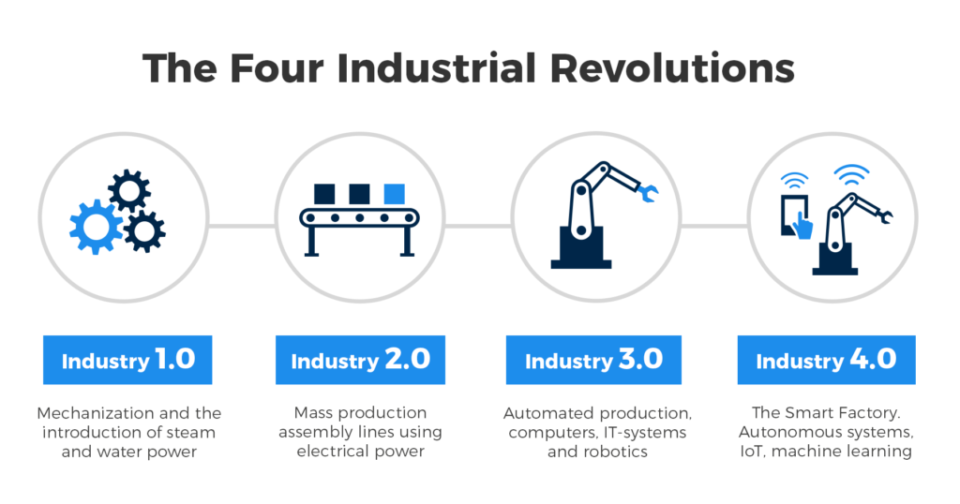

Bibliometric Map of What Makes Up Industry 4.0 and Industry 5.0 Competences – The emerging “where” we are to compete globally.

Slide 19
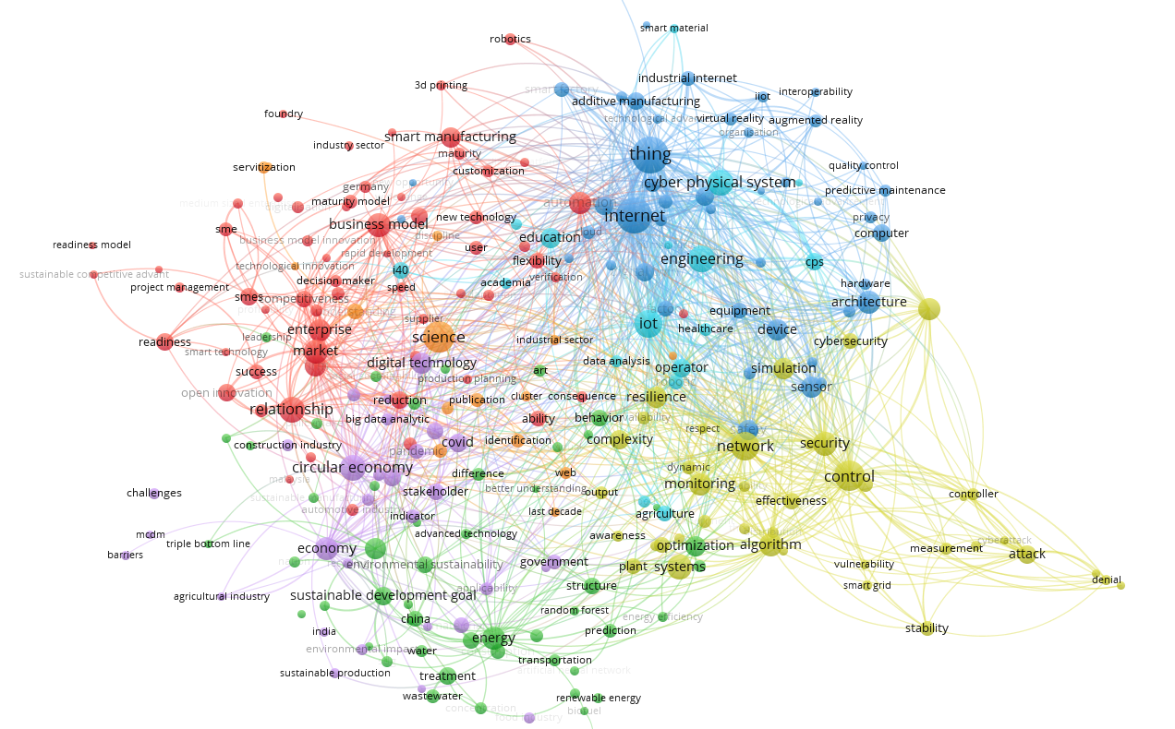
Industry 4.0 and Industry 5.0
Bibliometric Map: Source: Own Research

Slide 20
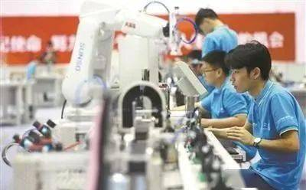
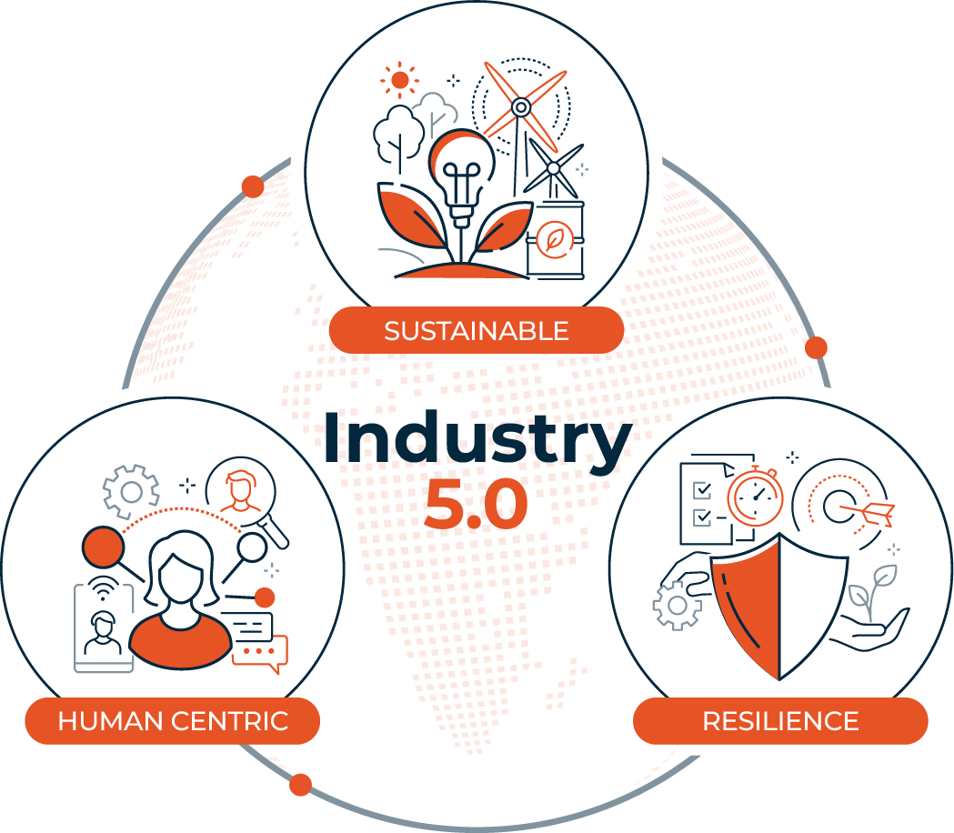
Industry 4.0 and I5.0
Competencies, Competences and Capabilities
Key Drivers
Cyber-Physical System
Smart Businesses
SCM, Stakeholders, Sustainable Economy, Big Data Analytics and Digital Technology
Intelligence Infrastructure and Smart Factory
Sustainable Development Goals
Intelligence Systems and Resilience

Slide 21
Implications for “Career Orientation”:
Towards a More Structural Contribution
Exploratory
Structural
That aims for more systematic competence-career orientation research and knowledge being created.

Slide 22
Instrumentality
Organization
Global Mindset and Globally Competent
Supports Globally Competent Organization
Value
Talent- and value-based: Creativity, entrepreneurial, managerial, technical, functional, service to a cause.
Competence
Needs-based Career Orientation - Job security
- work-life balance lifestyle
Stability
Flexibility
Protean Career Orientation
Boundaryless Career Orientation
Self
Suggesting a Knowledge Structure for Characterizing “Career Orientation”

Slide 23
Instrumentality
Employee Value
=
Competence (technical, managerial, entrepreneurial, AI, project, hybrid competencies) * Value Alignment with Organization (needs and values: stability and flexibility) * Instrumentality: self and organization
=
Career Orientation
Value
Know-What
Competence
Core Competence
Dynamic Capability
Know-Why and Know-Whom

Slide 24

To sum up, as a higher learning institution

Slide 25
We:
Promote an educational philosophy (know-why) and infrastructure and curriculum design (know-how and know-whom) that further supports the competency needs of the industry such as I4 and I5 for competitive advantage, both benefiting individuals and organizations.

Slide 26
And, We:
Socialize and cultivate our students with know-why competencies, embedded in a global mindset and know-whom competencies, so they can be actively engaged in know-what competencies development that differentiates out from the crowds.

Slide 27
And, We:
Actively pursue translating know-why, know-what, and know-whom competencies into greater diffusion to industries and societies within the nation and globally.

Slide 28
In short, career orientation career happiness and success, based on the following model (exploratory research outcome) Employee Value
- Self-, Organizational-, Network-, Technological, Ethical Instrumentality
Instrumentality
(Not only Inward Value- but Outward Oriented – What we should offer to organizations and businesses) with “values”
Value
Know-Why
Competence
Know-Whom
(Multidisciplinary, Multi-Cultural, Global Mindset, Communication)
Know-What

Slide 29

Thank you
And we look for wider and deeper research and academic collaborations together
Dr. C.C. Tan

