Slide 1
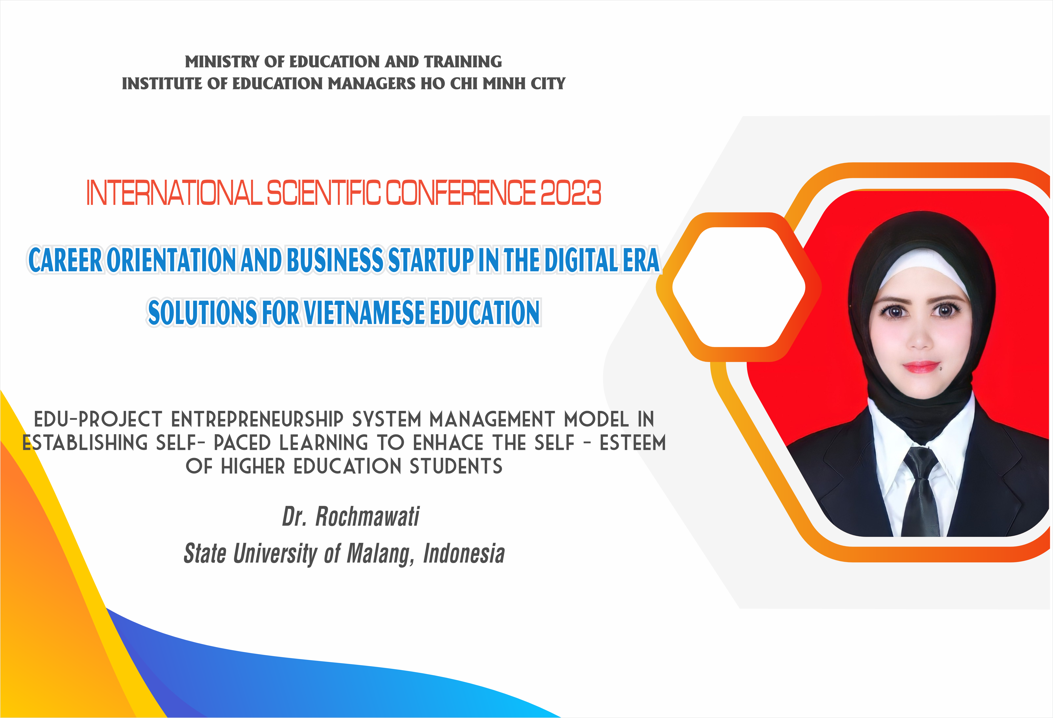

Slide 2


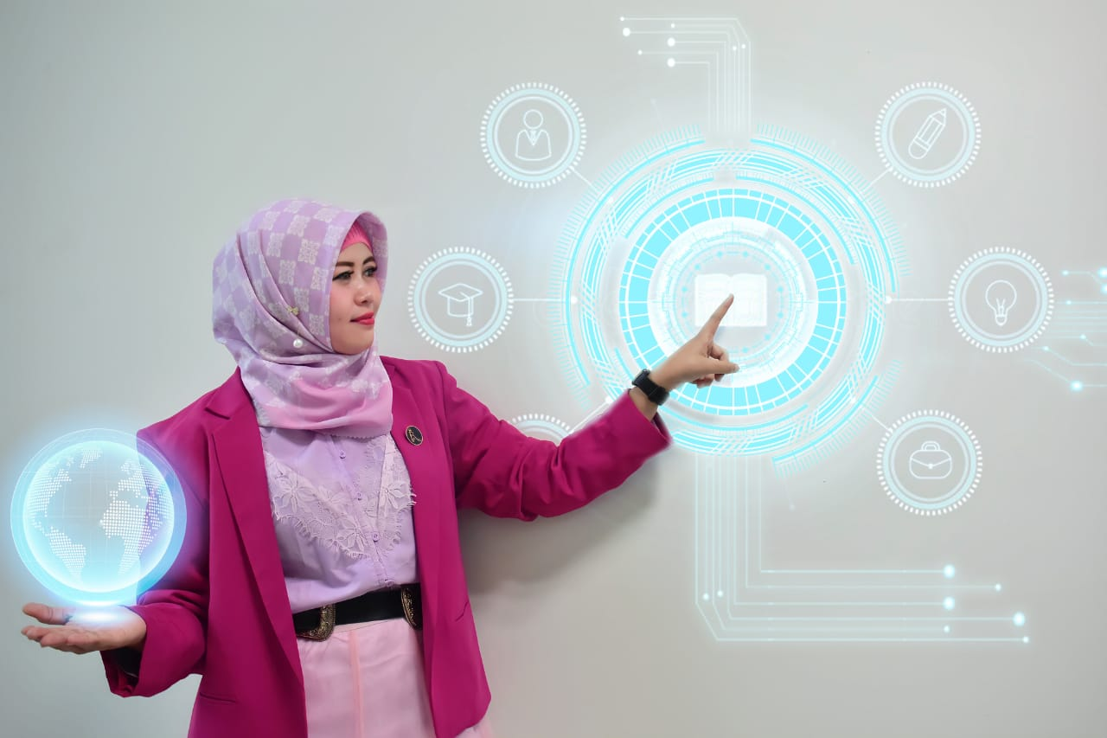



INTERNATIONAL SCIENTIFIC CONFERENCE 2023
“Career Orientation and Business Start-Up In the Digital Era Solution for Vietnamese Education”
EDU-PROJECT ENTREPRENEURSHIP SYSTEM MANAGEMENT MODEL IN
ESTABLISHING SELF-PACED LEARNING TO ENHACE THE SELF-ESTEEM OF HIGHER EDUCATION STUDENTS
Dr. Rochmawati, M. Pd
Ho Chi Minh City, 30 November 2023
International Consultant in Educational Management
State University of Malang
+6282140295086
Rochmawati.fip@um.ac.id

Slide 3


ASEAN Community Vision 2025 puts forward efforts to increase regional integration and connectivity through digital technology, and encourages a collaborative education ecosystem to support the exchange of knowledge among institutions, educators and students throughout ASEAN
Education is a powerful transformative force in the lives of ASEAN peoples. Thus inclusive and quality education is key to the sustainable development of the region
Aside from being a powerful driver of social and economic development, education has the potential to raise ASEAN awareness and foster a regional identity

Slide 4
Education is a process to improve the quality of human resources. Career opportunities for learners is an important issue that universities must put priority.
To build it, entrepreneurship education is needed in an effort to provide 'provisions' in facing global competitiveness. Society 5.0 does not only focus on technology, but personality development needs to receive main attention in building entrepreneurial character.
Global Competitive - Inovation and Collaboration - Actualization → Self-Quality becomes an urgent matter and an essence that must be improved self-esteem in higher education. Universities have an obligation to educate and foster an entrepreneurial spirit.
The importance of entrepreneurship education is not only for now, or in the coming year but in continuous improvement for the development of a generation of world civilization that is reliable, competent, innovative and characterized.

Slide 5

Edu-project entrepreneurship system management is one of the efforts to produce a competitive and quality generation, namely through self-paced learning based on the Business Model Canvas (BMC) to establish self-esteem in higher education
This component: Key Partner-Key activities-Key Resources-Value Propotion-Customer Relationship- Chanel-Customer Segments-Cost Structure-Revenue Streem
Self Paced to Improve Your Personality and Quality: Increasing ability road map career – agility and identifiying future opportunities, and tips and trick to identified customer satisfaying

Slide 6






Self-Paced Learning
Style of learning where individuals have the flexibility to set their own pace for acquiring knowledge or skills.
Edu-project Entrepreneurship
Projects or initiatives in an educational context that have a focus or aim to develop entrepreneurial skills or provide entrepreneurship-related education
Business Model Canvas (BMC)
A framework used to design, describe, and visualize the key elements of a business model.
Self-Quality/Esteem
A person's positive or negative judgment and perception of himself. This includes self-confidence, courage, and self-satisfaction.
Higher Education
A level of education usually attained after completing primary and secondary education, and often focused on imparting higher level knowledge and skills

Slide 7


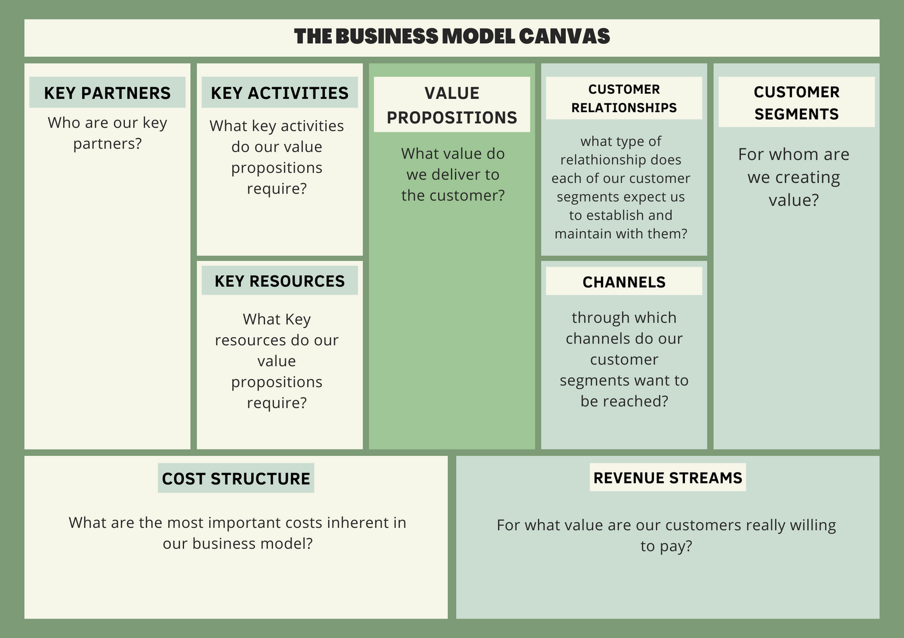
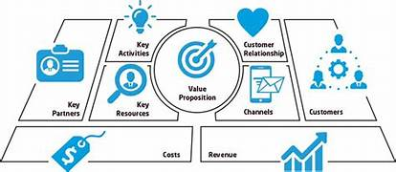
Is a basic template of a management strategy that is used in starting the initial design of a business or developing an existing business.

Slide 8

PRINCIPLE
Spesific:
Formulated in detail with efforts to achieve activities effectively and efficiently
S
M
Measurable:
Goals must be measurable between the plan and the target market
Attainable:
applicable
A
R
Result-oriented:
Orinted in quality process → Quality Development
Time-related:
Time management→ quality service→ customer satisfaying
T

Slide 9

Customer Satisfacion Indicator
Tangibles
Physical evidence, facilities, human resources, and communication
Reliability
01
The ability to provide services promptly, accurately and satisfactorily
Responsiveness
The desire of the staff to help customers and provide responsive service
02
Assurance
Includes knowledge, skills, courtesy and trustworthiness of staff, free from risk and danger.
Empati
03
The desire of the staff to help customers and provide responsive service
04
05

Slide 10
Edu-project entrepreneurship system management model can give provide provisions in building global quality human resources to increase ability roadmap career for students in higher education
Higher education can plan key activities that support their adaptation, identify necessary resources, evaluate effective distribution channels, and increase the effectiveness and efficiency of their learning
CONCLUSION
Designing a holistic strategy to improve agility and identifiying future opportunities, and tips and trick to identified customer satisfaying and growth adaptable with global competitiveness

Slide 11


rochmawati.fip@um.ac.id

